Slide 1

INTRODUCTION
TO HADOOP

Slide 2

What is Hadoop?
A system for processing big data
A framework for storing and organizing large scale data

Slide 3
What is Hadoop?
MapReduce
HDFS: The Hadoop Distributed File System

Slide 4
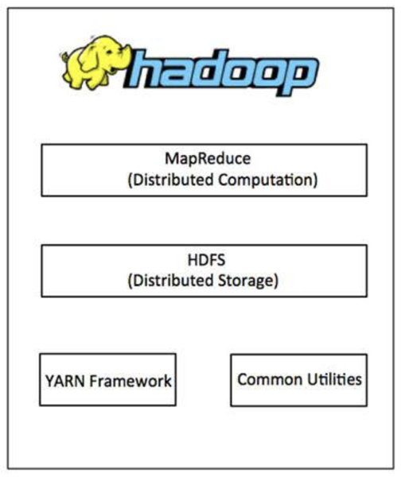
Plus some other managerial tools for making those goals happen

Slide 5
HDFS

Slide 6
Hadoop Distributed File System
The largest legacy from Hadoop is HDFS
It’s a clever system for “chunking” our data up and storing it on lots of different computers for later use.
The storage points are called “nodes,” and they are distributed across a “cluster” of computers.
Notes:
We’re speaking from a 2018 perspective here

Slide 7
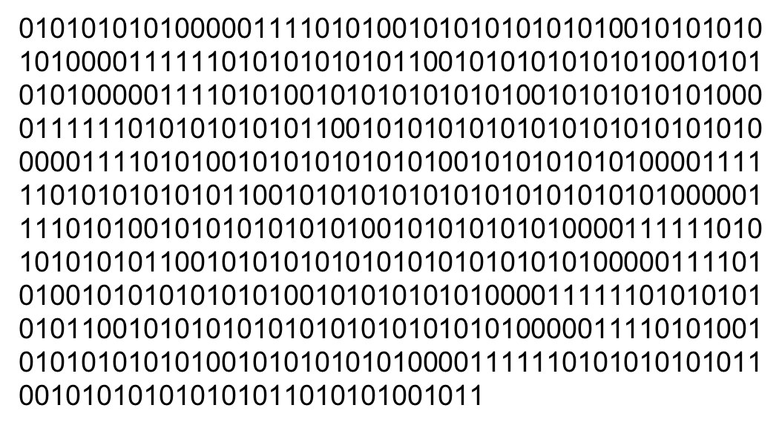
We have data. When we want to use it, we just load it up and go.

Slide 8
So far, we’ve always been in this situation.
RAM

Slide 9
What happens when we can’t fit everything in RAM?
RAM

Slide 10
We need a system that can handle all of this.
HDFS1
HDFS2
HDFS3
HDFS4

Slide 11
HDFS
HDFS chunks data into smaller blocks (128 MB default), and distributes those blocks across a cluster
It’s designed to work on “commodity” (read: old, unreliable) hardware. So it automatically creates backups of the data across the cluster.
It does this by using two types of “nodes” in the cluster
Notes:
Google used commodity hardware to compete with big players like IBM for much cheaper

Slide 12
Name Node
Data Node

Slide 13
Name Node
Data Node
Controls where the data lives.
Processes requests to add and find data on the cluster.
Stores metadata like permissions, disk space, data access information.

Slide 14
Name Node
Data Node
Controls where the data lives.
Processes requests to add and find data on the cluster.
Stores metadata like permissions, disk space, data access information.
Stores data.
Listens to the NameNode for commands and requests
Stores block-data information (like verification pieces)
Notes:
You may run across the old “master/slave” naming scheme. Use the new scheme!

Slide 15
LET’S ‘BUILD’ A CLUSTER TO SEE IT ALL IN ACTION

Slide 16
I’d like a cluster please!
Node
Node
Node
Node
Node
Node
Node

Slide 17
I’d like a cluster please!
Node
Node
Node
Node
Node
Node
Node
Node
Name Node
Node
Node
Node
Node

Slide 18
Node
Node
Node
Node
Node
Node
Node
Node
Name Node
Node
Node
Node
Node

Slide 19
Node
Node
Node
Node
Node
Node
Node
Node
Name Node
Node
Node
Node
Node

Slide 20
Node
Node
Node
Node
Node
Node
Node
Node
Name Node
Node
Data
Node
Node

Slide 21
Node
Node
Node
Node
Node
Node
Node
Node
Name Node
Node
Data
Node
Node

Slide 22
Data
Node
Data
Node
Node
Data
Node
Name Node
Data
Node
Data
Node

Slide 23
Data
Node
Data
Node
Node
Data
Node
Name Node
Data
Node
Data
Node

Slide 24
Data
Node
Data
Node
Data
Node
Name Node
Data
Node
Data
Node
Name Node

Slide 25
Data
Node
Data
Node
Data
Node
Name Node
Data
Node
Data
Node
Name Node

Slide 26
Add this data to the cluster
Data
Node
Data
Node
Data
Node
Name Node
Data
Node
Data
Node
Name Node

Slide 27
Add this data to the cluster
Data
Node
Data
Node
Data
Node
Name Node
The system chunks the data, moves those chunks to data nodes, and then makes sure the data is backed up across many nodes.
Data
Node
Data
Node
Name Node

Slide 28
Data
Node
Data
Node
Data
Node
Name Node
Data
Node
Data
Node
Name Node

Slide 29
Data
Node
Data
Node
Data
Node
Name Node
Data
Node
Data
Node
Name Node

Slide 30
Data
Node
Data
Node
Data
Node
Name Node
Data
Node
Data
Node
Name Node

Slide 31
Data
Node
Data
Node
Data
Node
Name Node
Data
Node
Data
Node
Name Node

Slide 32
Data
Node
Data
Node
Data
Node
Name Node
Data
Node
Data
Node
Name Node

Slide 33
Data
Node
Data
Node
Data
Node
Name Node
Data
Node
Data
Node
Name Node
Notes:
Notice complete duplication!

Slide 34
WHAT IF WE WANT TO USE THE DATA?

Slide 35
I’d like section 1 of the data please.
Data
Node
Data
Node
Data
Node
Name Node
Data
Node
Data
Node
Name Node

Slide 36
Data
Node
Data
Node
10 ms to server
20 ms to server
Data
Node
Name Node
Data
Node
Data
Node
Name Node

Slide 37
Data
Node
Data
Node
Data
Node
Name Node
Data
Node
Data
Node
Name Node
Notes:
Faster wins

Slide 38
HDFS
Redundancy
Central control for a user
Data management through chunking

Slide 39
Commodity Hardware
It’s cheaper to scale horizontally. Can always tie in more nodes from older hard drives, hard to get a 2,000,000 TB single drive.
Allows us to salvage old systems and make a new, better system.
Redundancy makes us fault tolerant when old hardware dies.

Slide 40
Data
Node
Data
Node
10 ms to server
20 ms to server
Data
Node
Name Node
Data
Node
Data
Node
Name Node

Slide 41
X
Data
Node
Data
Node
Data
Node
Name Node
Data
Node
Data
Node
Name Node

Slide 42
Data
Node
Data
Node
Data
Node
Name Node
Data
Node
Data
Node
Name Node

Slide 43
HDFS I/O
HDFS supports:
Read
Write
Delete
Once the data is on HDFS, it’s read-only, except for appending. Makes it safe from idiots using the system.

Slide 44
MAPREDUCE

Slide 45
Processing Data
We have two options:
Pull the data from HDFS and process
Make use of the cluster to process

Slide 46
Pull-and-Process
HDFS
Notes:
How would we take on finding the average of all our data?

Slide 47
Pull-and-Process
HDFS

Slide 48
Pull-and-Process
HDFS

Slide 49
Pull-and-Process
HDFS

Slide 50
Pull-and-Process
HDFS

Slide 51
Pull-and-Process
Bottleneck
HDFS

Slide 52
Use the Cluster
HDFS
HDFS
HDFS
HDFS

Slide 53
Use the Cluster
HDFS
HDFS
HDFS
HDFS
Notes:
Use nodes to find averages

Slide 54
Use the Cluster
HDFS
HDFS
This is called a Mapping Stage
HDFS
HDFS

Slide 55
Use the Cluster
HDFS
HDFS
4.75
HDFS
HDFS
HDFS

Slide 56
Use the Cluster
This is called a Reducing Stage
HDFS
HDFS
4.75
HDFS
HDFS
HDFS
4.75

Slide 57
MapReduce
The “ah-ha” of MapReduce is to push the work to the data
Transferring scripts is easy. Transferring data is hard.
“Convert a big problem into lots of small problems”

Slide 58
Map Phase
Processes data on each node and outputs to a collection stream.
Can be anything that has consistent output
Can work on rows or blocks or raw text, etc.

Slide 59
Reduce Phase
Takes all the outputs from the Mappers and combines them into a condensed output
Could be averaging or counting or filtering or whatever you can code
Passes output to either next reducing phase or back to the user

Slide 60
USING MAPREDUCE TO COUNT WORDS
Notes:
Can you think of how this would be done?

Slide 61
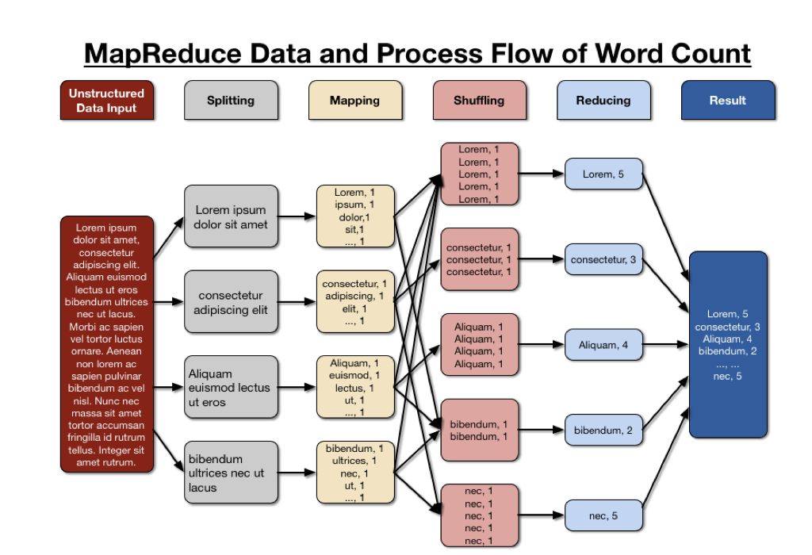
We load our data onto HDFS and have it chunked up into different DataNodes.
If we want to count the total number of occurrences for each word, how could we do it with mapping?

Slide 62
We have each a program that writes each word into a stream. It’s traditional to do it in key-value pairs. So we see:
word, 1 (appearance)

Slide 63
One of the keys to MapReduce is to write data only to the stream. No objects that require long-term memory, so we can’t use dictionaries to count.
So how can we reduce?

Slide 64
Sometimes we sort the data via a “shuffle” stage to help the reducer be more efficient.
Now that the data looks like this, how could we reduce?

Slide 65
Source: http://bit.ly/2zueMbJ
Notes:
Notice we didn’t use hashing and had multiple “keys”. So lookups are slower but sorting and counting is faster

Slide 66
When should I use Hadoop?
Massive data. Must be at multiple terabytes or it simply isn’t worth the overhead of maintaining a cluster.
Hadoop isn’t a “machine learning tool”. It’s about maintaining, pipelining, and cleaning data. We can make it do ML, but remember that it’s designed for ETL.
MapReduce reads from hard drive, so it can work, but it’s slower than from RAM.
Notes:
Spark improves on this!

Slide 67
What else should I know?
There’s a whole suite of Hadoop based tools:
Hive allows SQL queries to become MapReduce programs automatically
Pig is another processing library that looks a lot like SQL
Sqoop allows you to load data from SQL databases to HDFS
Hadoop is mature and well supported; if you need something, someone has likely built it.

Slide 68
HIVE
Hive auto-converts SQL queries into MapReduce programs and can run on distributed data
Can work with both structured and unstructured data using a special version of SQL called HiveQL
Extremely robust to faults and great for exploring data
Essentially allowed the use of Hadoop as an analytics tool
Notes:
Facebook deployed HIVE

Slide 69
What else should I know?
However, almost all of the Hadoop tools are now outperformed by Spark.
So the main legacy of Hadoop is HDFS and its management tools like YARN. You don’t need to understand those deeply – but know that HDFS is special because almost all the big data tools use it (like Spark).
Understanding Hadoop and the Map-Reduce pattern forms the basis for all future big data technologies, so take this to heart.

Slide 70

QUESTIONS?

Slide 71
Cites
Pixel speech bubbles: https://pixelspeechbubble.com/

